Slide 3
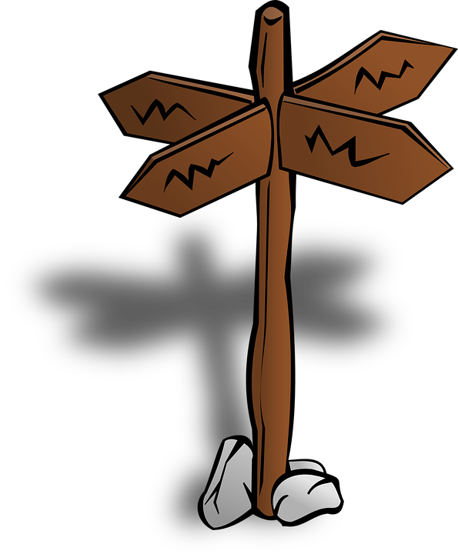
This is what the Lord says:
‘Stand where the roads cross and look.
Ask where the old way is,
Where the good way is, and walk on it.
If you do, you will find rest for your souls.’
Jeremiah 6:16 (NCV)

